Slide 1
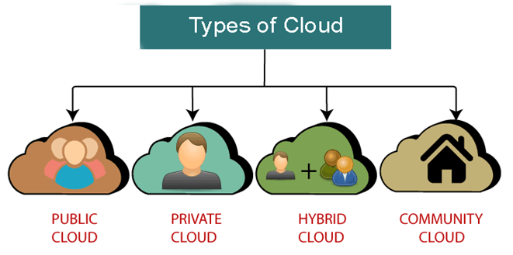
Types of Cloud
There are the following 4 types of cloud that you can deploy according to the organization's needs.

Slide 2
Public Cloud
The public cloud is open to all to store and access information via the Internet using the pay-per-usage method.
Public Cloud provides a shared platform that is accessible to the general public through an Internet connection.
The public cloud operated on the pay-as-per-use model and is administrated by a third party, i.e., the Cloud service provider.
In the Public cloud, the same storage is being used by multiple users at the same time.
The public cloud is owned, managed, and operated by businesses, universities, government organizations, or a combination of them.
Example: Amazon elastic compute cloud (EC2), IBM SmartCloud Enterprise, Microsoft, Google App Engine, Windows Azure Services Platform.

Slide 3
Advantages of Public Cloud
There are the following advantages of Public Cloud
Public cloud is owned at a lower cost than the private and hybrid cloud.
Public cloud is maintained by the cloud service provider, so do not need to worry about the maintenance.
Public cloud is easier to integrate. Hence it offers a better flexibility approach to consumers.
Public cloud is location independent because its services are delivered through the internet.
Public cloud is highly scalable as per the requirement of computing resources.
It is accessible by the general public, so there is no limit to the number of users.

Slide 4
Disadvantages of Public Cloud
Public Cloud is less secure because resources are shared publicly.
Performance depends upon the high-speed internet network link to the cloud provider.
The Client has no control of data.

Slide 5
Private Cloud
A private cloud is also known as an internal cloud or corporate cloud. It is used by organizations to build and manage their own data centers internally or by a third party.
It can be deployed using Open source tools such as Openstack and Eucalyptus.
The private cloud provides a high level of security and privacy to data through firewalls and internal hosting. It also ensures that operational and sensitive data are not accessible to third-party providers.
Examples: HP Data Centers, Microsoft, Elastra-private cloud, and Ubuntu
Based on the location and management, the National Institute of Standards and Technology (NIST) divides private cloud into the following two parts-
On-premise private cloud
Outsourced private cloud

Slide 6
Advantages of Private Cloud
There are the following advantages of the Private Cloud -
Private cloud provides a high level of security and privacy to the users.
Private cloud offers better performance with improved speed and space capacity.
It allows the IT team to quickly allocate and deliver on-demand IT resources.
The organization has full control over the cloud because it is managed by the organization itself. So, there is no need for the organization to depends on anybody.
It is suitable for organizations that require a separate cloud for their personal use and data security is the first priority.

Slide 7
Disadvantages of Private Cloud
Skilled people are required to manage and operate cloud services.
Private cloud is accessible within the organization, so the area of operations is limited.
Private cloud is not suitable for organizations that have a high user base, and organizations that do not have the prebuilt infrastructure, sufficient manpower to maintain and manage the cloud.

Slide 8
Hybrid Cloud
A hybrid Cloud is a combination of the public cloud and the private cloud. we can say:
Hybrid Cloud = Public Cloud + Private Cloud
A hybrid cloud is partially secure because the services which are running on the public cloud can be accessed by anyone, while the services which are running on a private cloud can be accessed only by the organization's users.
The main aim to combine these cloud (Public and Private) is to create a unified, automated, and well-managed computing environment.
In the Hybrid cloud, non-critical activities are performed by the public cloud and critical activities are performed by the private cloud.
Examples: Google Application Suite (Gmail, Google Apps, and Google Drive), Office 365 (MS Office on the Web and One Drive), Amazon Web Services.

Slide 9
Advantages of Hybrid Cloud
There are the following advantages of a Hybrid Cloud -
A hybrid cloud is suitable for organizations that require more security than the public cloud.
The hybrid cloud helps you to deliver new products and services more quickly.
The Hybrid cloud provides an excellent way to reduce risk.
The hybrid cloud offers flexible resources because of the public cloud and secure resources because of the private cloud.

Slide 10
Disadvantages of Hybrid Cloud
In Hybrid Cloud, the security feature is not as good as the private cloud.
Managing a hybrid cloud is complex because it is difficult to manage more than one type of deployment model.
In the hybrid cloud, the reliability of the services depends on cloud service providers.

Slide 11
Community Cloud
Community cloud allows systems and services to be accessible by a group of several organizations to share the information between the organization and a specific community.
It is owned, managed, and operated by one or more organizations in the community, a third party, or a combination of them.

Slide 12
Advantages of Community Cloud
There are the following advantages of Community Cloud -
The community cloud is cost-effective because the whole cloud is being shared by several organizations or communities.
The community cloud is suitable for organizations that want to have a collaborative cloud with more security features than the public cloud.
It provides better security than the public cloud.
It provides a collaborative and distributive environment.
Community cloud allows us to share cloud resources, infrastructure, and other capabilities among various organizations.

Slide 13
Disadvantages of Community Cloud
Community cloud is not a good choice for every organization.
Security features are not as good as the private cloud.
It is not suitable if there is no collaboration.
The fixed amount of data storage and bandwidth is shared among all community members.

Slide 14
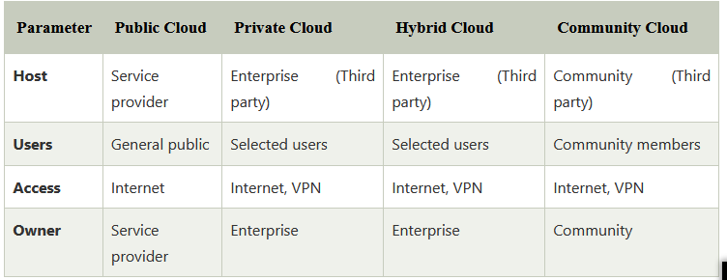
Difference between public cloud, private cloud, hybrid cloud, and community cloud

